Slide 1

A Fusion Approach to Infrared and Visible Images
Date: 27th May 2021
Ms. RAHELA MAHENAZ : 17WH1A0595
Ms. P. DIVYA REKHA : 18WH5A0515
Ms. A. SRAVYA : 17WH1A0590
Internal Guide: Ms.G.NAGAMANI
Designation: Assistant Professor
Department of Computer Science & Engineering
BVRIT HYDERABAD College of Engineering for Women

Slide 2

Why Should I Study this course?
ABSTRACT
The infrared and visible image fusion task is an important problem in image processing field. It attempts to extract salient features from source images, then these features are integrated into a single image by appropriate fusion method. It is a novel deep learning architecture for infrared and visible images fusion problems. In contrast to conventional convolutional networks, our encoding network is combined with convolutional layers, a fusion layer, and dense block in which the output of each layer is connected to every other layer. We attempt to use this architecture to get more useful features from source images in the encoding process, and two fusion layers (fusion strategies) are designed to fuse these features. We use encoding network to extract image features and the fused image is obtained by decoding network. Finally, the fused image will be reconstructed by fusion strategy and decoding network which includes four CNN layers
Examples
BVRIT HYDERABAD College of Engineering for Women

Slide 3
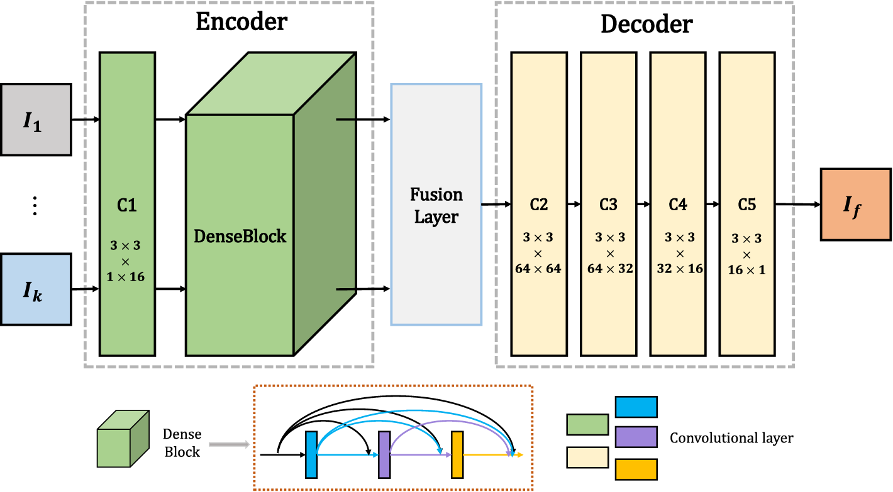
Why Should I Study this course?
Architecture
Examples
BVRIT HYDERABAD College of Engineering for Women

Slide 4
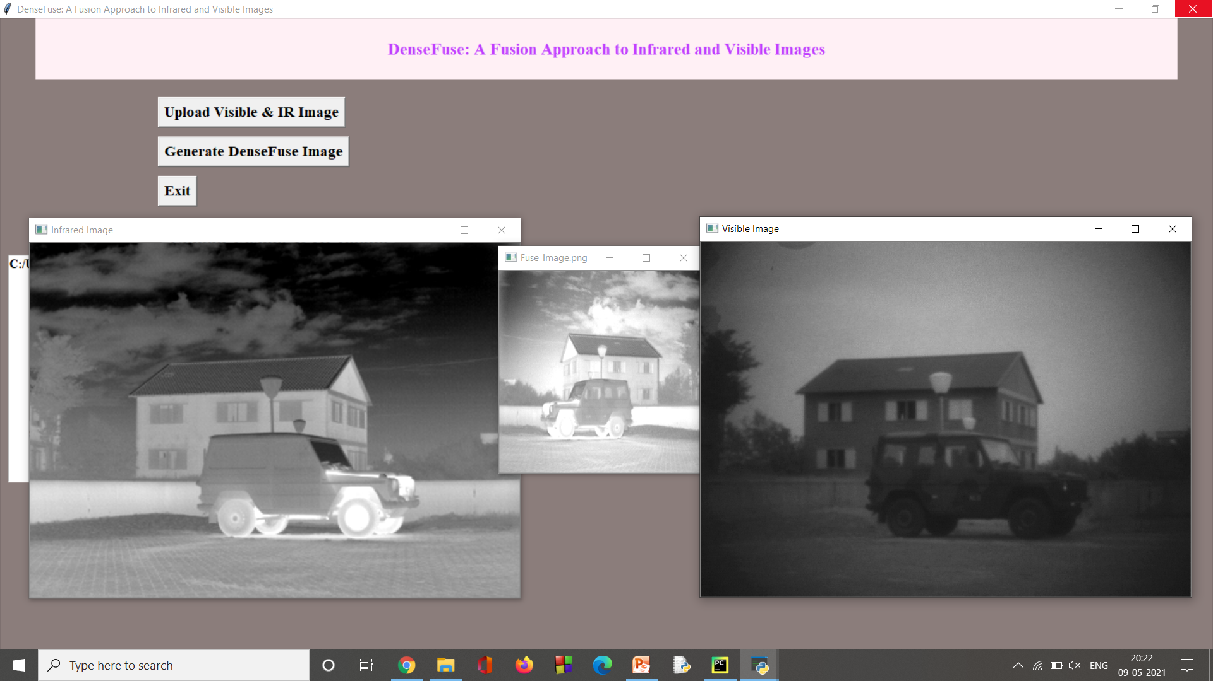
Why Should I Study this course?
OUTPUT
Examples
BVRIT HYDERABAD College of Engineering for Women

Slide 5
Comparisions
For the purpose of quantitative comparison between our fusion method and other existing algorithms, seven quality metrics are utilized.
The proposed method if compared with several typical fusion methods, including cross bilateral filter fusion method(CBF), the joint-sparse representation model(JSR), gradient transfer and total variation minimization(GTF), the JSR model with saliency detection fusion method(JSRSD) , deep convolutional neural network-based method(CNN) and the Deep Fuse method.With different fusion strategy (addition and l1-norm) utilized in to our network, our algorithm still has best or second-best values in seven quality metrics. This means our network is an effective architecture for infrared and visible image fusion task.
BVRIT HYDERABAD College of Engineering for Women

Slide 6
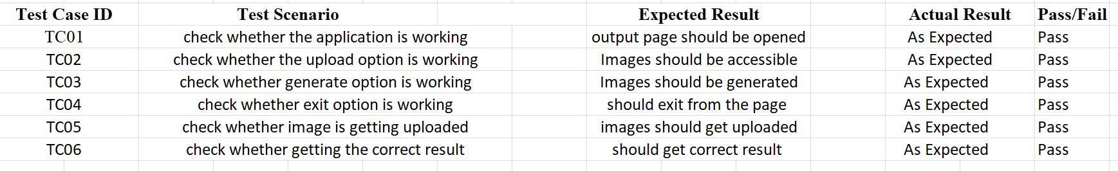
Test Cases
BVRIT HYDERABAD College of Engineering for Women

Slide 7
Thank You
BVRIT HYDERABAD College of Engineering for Women

